Slide 1
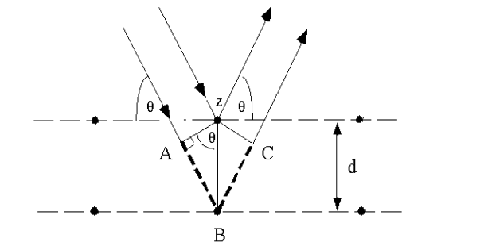
Characterization of Polymers
X-Ray Diffraction
This generally leads to an understanding of the material and molecular structure of a substance. The spacing in the crystal lattice can be determined using Bragg's law. The electrons that surround the atoms, rather than the atomic nuclei themselves, are the entities that physically interact with the incoming X-ray photons. This technique is widely used in chemistry and biochemistry to determine the structures of an immense variety of molecules, including inorganic compounds, DNA, and proteins. X-ray diffraction is commonly carried out using single crystals of a material, but if these are not available, microcrystalline powdered samples may also be used, although this requires different equipment, gives less information, and is much less straightforward.
Dr.Widad.Saleh

Slide 2
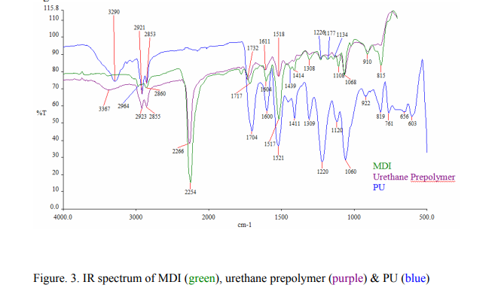

Slide 3
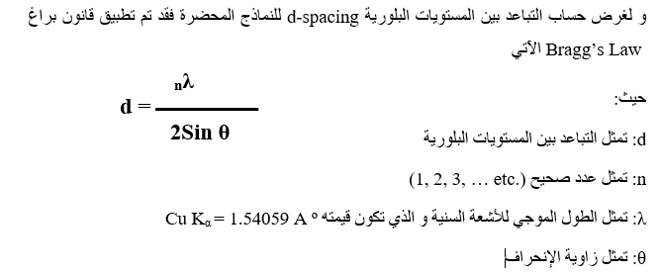
من ناحية اخرى يتم حساب الحجم البلوري للمادة او للبوليمر في حالة كونه نانوي من قاون اخر يسمى قانون شيرر
Dr.Widad.Saleh

Slide 4
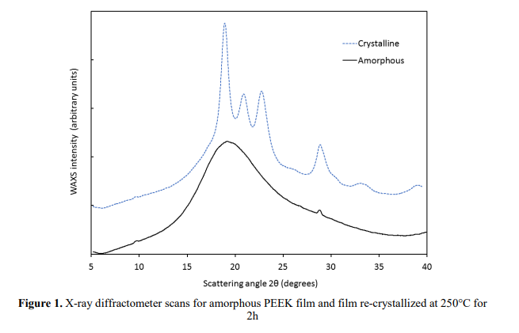
Dr.Widad.Saleh

Slide 5
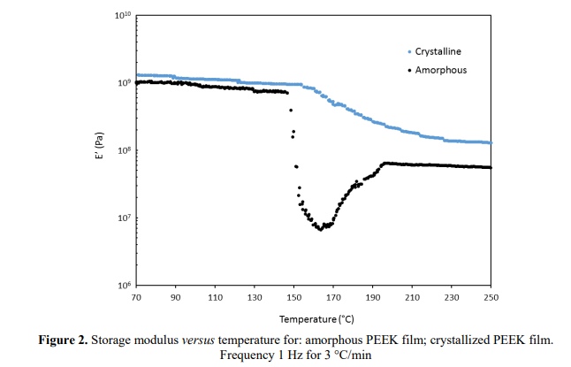
Dr.Widad.Saleh

Slide 6
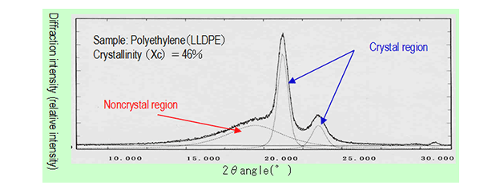
Measurement of Degree of Crystallinity of Polymer by X-ray Diffraction Analysis
Q: show how to calculate the degree of crystallinity from DSC thermograms .
Dr.Widad.Saleh

Slide 7
Chemical Resistance
1- Resistance to solvents
2- Permeability
Dr.Widad.Saleh

Slide 8
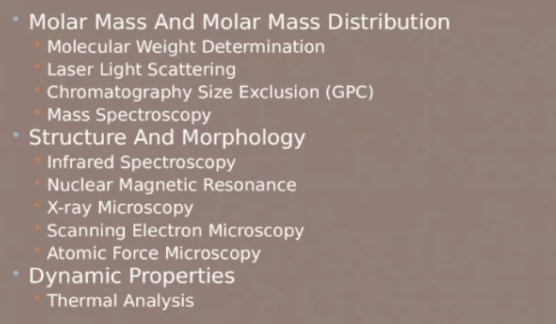
Dr.Widad.Saleh

Slide 9
Dr.Widad.Saleh

Slide 11
Dr.Widad.Saleh

Slide 12
Dr.Widad.Saleh

Slide 13
Dr.Widad.Saleh

Slide 14
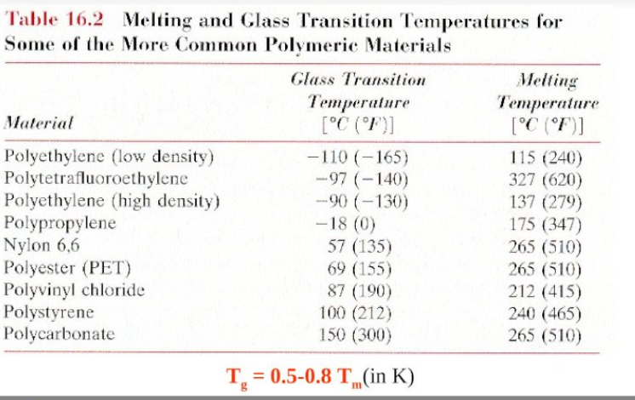
Dr.Widad.Saleh

Slide 15
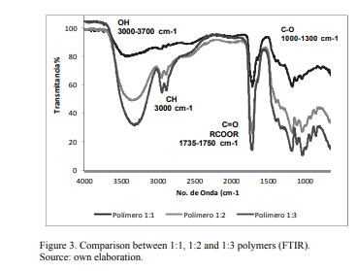
FTIR -Example
Dr.Widad.Saleh

Slide 16
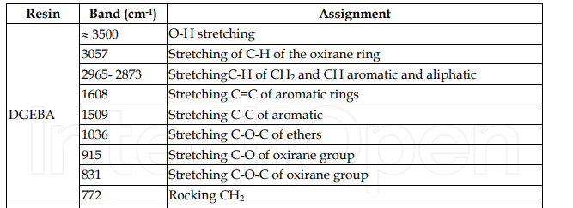
Epoxy resin

Slide 17
Polyurethane
Dr.Widad.Saleh

Slide 18
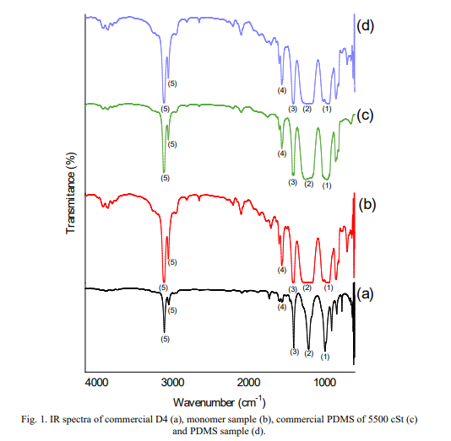
Polysiloxane

Slide 19
Finally , polymer characterization Tech.used to determine …..molecular mass, molecular structure, morphology, thermal properties and mechanical properties.
The molecular mass of a polymer differs from typical molecules, in that polymerization reactions produce a distribution of molecular weights and shapes.
Many of the analytical techniques used to determine the molecular structure of unknown organic compounds are also used in polymer characterization. Spectroscopic techniques.
Polymer morphology is a microscale property that is largely dictated by the amorphous or crystalline portions of the polymer chains and their influence on each other.
A true workhorse for polymer characterization is thermal analysis, particularly Differential scanning calorimetry. Changes in the compositional and structural parameters of the material usually affect its melting transitions or glass transitions and these in turn can be linked to many performance parameters, whileThermogravimetric analysis can also give an indication of polymer thermal stability and the effects of additives such as flame retardants
The characterization of mechanical properties in polymers typically refers to a measure of the strength, elasticity, viscoelasticity, and anisotropy of a polymeric materia
Dr.Widad.Saleh

